Slide 1
Land grabbing in the Colombian Altillanura
Dynamics of conflict and development
Accumulation of baldíos

Slide 2
Key concepts
Primitive accumulation
Accumulation by dispossession
Collective or public lands are thus transformed into private property

Slide 3
The concept of Baldíos
These lands are not owned and consequently, belong to the State. (public lands).
These lands are intended for use in redistribution programs.
the State issues property titles to peasants who have low incomes, lacking other rural lands within the national territory

Slide 4
The origin of Baldíos
Since the beginnings of the Colombian republic: turning the land into private property
large expanses of land remained without any ownership. They often became the object of disputes.

Slide 5
Appropriation methods
The selling of Baldíos to pay off public debts
The awarding of Baldíos to members of the independentist armies
Baldíos for immigrants as a reward for populating certain regions.
Illegal appropriation of Baldíos.
The awarding of Baldíos to foreign companies
The appropriation of Baldíos located around swamps or lakes cattle raising.
Through violence against black and indigenous peoples.

Slide 6
Origin of land inequality
Most of these lands were awarded to entrepreneurs and capitalists, whilst settlers obtained the marginal areas.
More important than socioeconomic development, was the influence of large landholders, merchants, politicians and military forces.
social structure based on the concept of land intrinsically as a source of wealth, rather than as primarily something to use for cultivation.

Slide 7
The Baldíos regulation
According to the Colombian Constitution of 1991.
Baldíos may only be acquired by means of titles issued by the state, now represented by the National Agency of Lands
Beneficiaries must have a patrimony up to 250 legal minimum monthly wages and cannot be owners of any other rural land in the country.
purchasing contracts will be considered illegal if a property that exceeds the Family Agricultural Unit is formed

Slide 8
BALDÍOS IN COLOMBIA

Slide 9
land grabbing in Colombia
Land grabbing entails acquisition or control of lands with the specific purpose of carrying out large-scale projects according to the needs of capitalism
today, for example, there is a strong demand for biofuels, mining and infrastructure
Land grabbing and crisis

Slide 10
Current situation of biofuels in Colombia
Act 693 of 2001 orders the use in gas consumed in urban centers
Act 939 of 2004 allowing their use in diesel motors, exempting it from taxes such as VAT.
Decree 4892 of 2011 necessitates that consumed gas must be a mixture consisting of 10% fuel alcohol combined with basic gasoline.
Up to 82 % of consumed ethanol is internally produced. Nevertheless, it is not enough for fulfilling the national E10 requirement (90 % gasoline; 10% ethanol).
Lobby for increasing production

Slide 11
Current situation of biofuels in Colombia

Slide 12
Forced displacement and dispossession
During the eighties, drug lords and paramilitary groups appropriated 4.4 million hectares for laundering their ill-gotten fortunes and controlling territories used in drug production.
Sources indicate that the armed conflict has displaced more than 5.1 million people and that 6.6 million hectares have been dispossessed (Salinas, 2012).

Slide 13
Forced displacement and dispossession
Actors: Armed groups, such as guerrilla bands and various paramilitary forces, are not the main actors.
Also cattle ranchers, drug barons, land speculators, institutional authorities and both intra-national and international firms.
transformation of extensive tracts land once dominated by small scale agriculture.

Slide 14
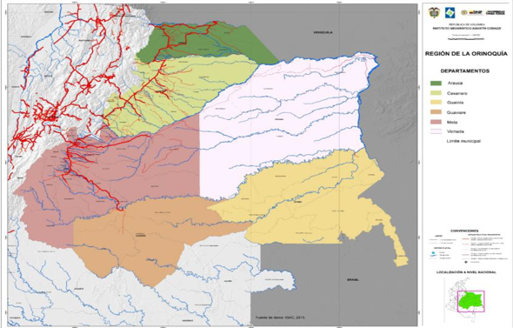
The Altillanura subregion

Slide 15
The Altillanura subregion
Colombia has 21.8 million cultivatable hectares, of which 5.5% (1.2 million hectares) are located in Altillanura.
Savannas are predominant in Altillanura, Its soils are highly acidic and poor (low availability of plant nutrients). Agriculture is limited by fertility conditions, poor infrastructure and lack of technical support for production.
By 2016 the region had 48.569 hectares occupied by oil palm and 17.408 by sugarcane.

Slide 16
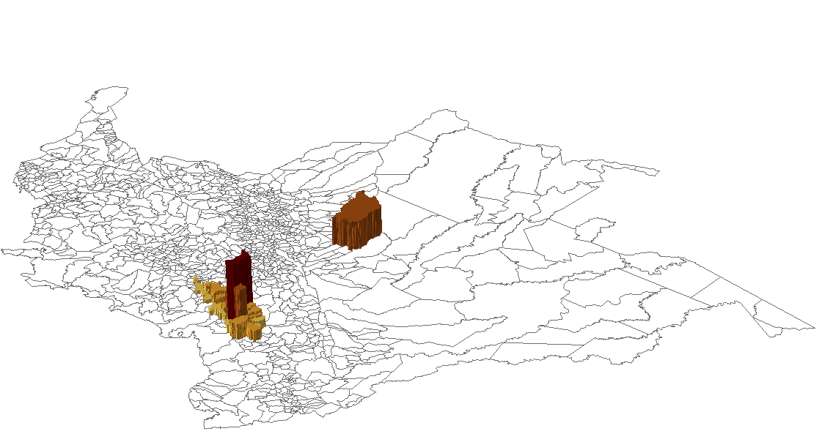
Commodities in Colombia

Slide 17
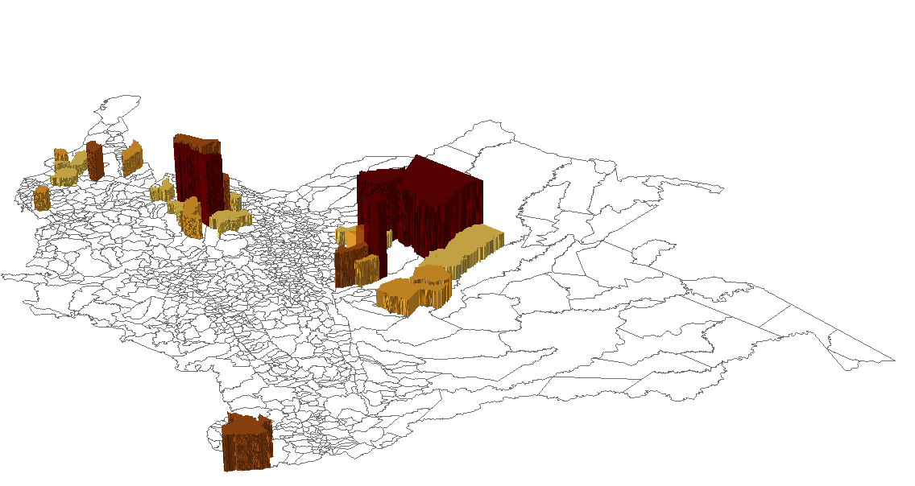
Commodities in Colombia

Slide 18
The development model of Altillanura
The Colombian State: it is necessary to encourage the participation of small, middle and large producers for creating economies of scales.
Securing property rights. A new Baldíos management program: awarding the lands with the best attributes to landless peasants.
Allocating the use of those Baldíos that have inferior qualities: large producers or companies: mechanisms other than owning the land, such as renting or concession contracts
The origins of the model: El Cerrado in Brazil: concentration, erosion, depletion of water.

Slide 19
forced displacement and dispossession in Altillanura
2014. Puerto Gaitán and Mapiripán were municipalities that had more areas requested for restitution: 146.842 and 206.657 hectares respectively Both are located in the Colombian Altillanura.
El Brasil 1995 - 2005
Poligrow 80’ 1997 2009
Examples of primitive accumulation

Slide 20
Accumulation of baldíos in Altillanura
The Contraloría General de la República: irregular accumulation of Baldíos in Altillanura: Accumulating former baldíos prohibition.
Monica, Cargill, Sarmiento Angulo, Helm Trust, The Forest Company Wood-Timberland Holding, Manuelita, Poligrow and relatives of two former ministers of Agriculture were investigated.

Slide 21
Accumulation of baldíos in the Colombian altillanura
ICR: is an economic benefit intended to small or middle producers who invest in the agricultural sector in order to foster modernization, competitiveness and sustainability of agricultural production. They obtain a credit, which is partially paid by the state

Slide 22
Accumulation of baldíos in the Colombian altillanura
The case of Cargill.
CARGILL created 36 smaller shell companies, that acquired 39 former Baldíos in Santa Rosalía, Cumaribo and La primavera municipalities and in Vichada department
It thereby accumulated 52.575,51 hectares (OXFAM, 2013), without exceeding the Family Agricultural Unit
CARGILL was recipient of the ICR in ten operations by means of the shell company Colombia Agro, receiving in total COP 23.217.800.000

Slide 23
Conclusions
Unequal distribution of baldios are the basis of an ongoing unequal land structure.
Salient factors in land grabbing in Colombia: forced displacement and biofuels.
Altillanure subregion as a new agrarian frontier
Colombia meets both primitive accumulation and accumulation by dispossession scenarios.

